Slide 1
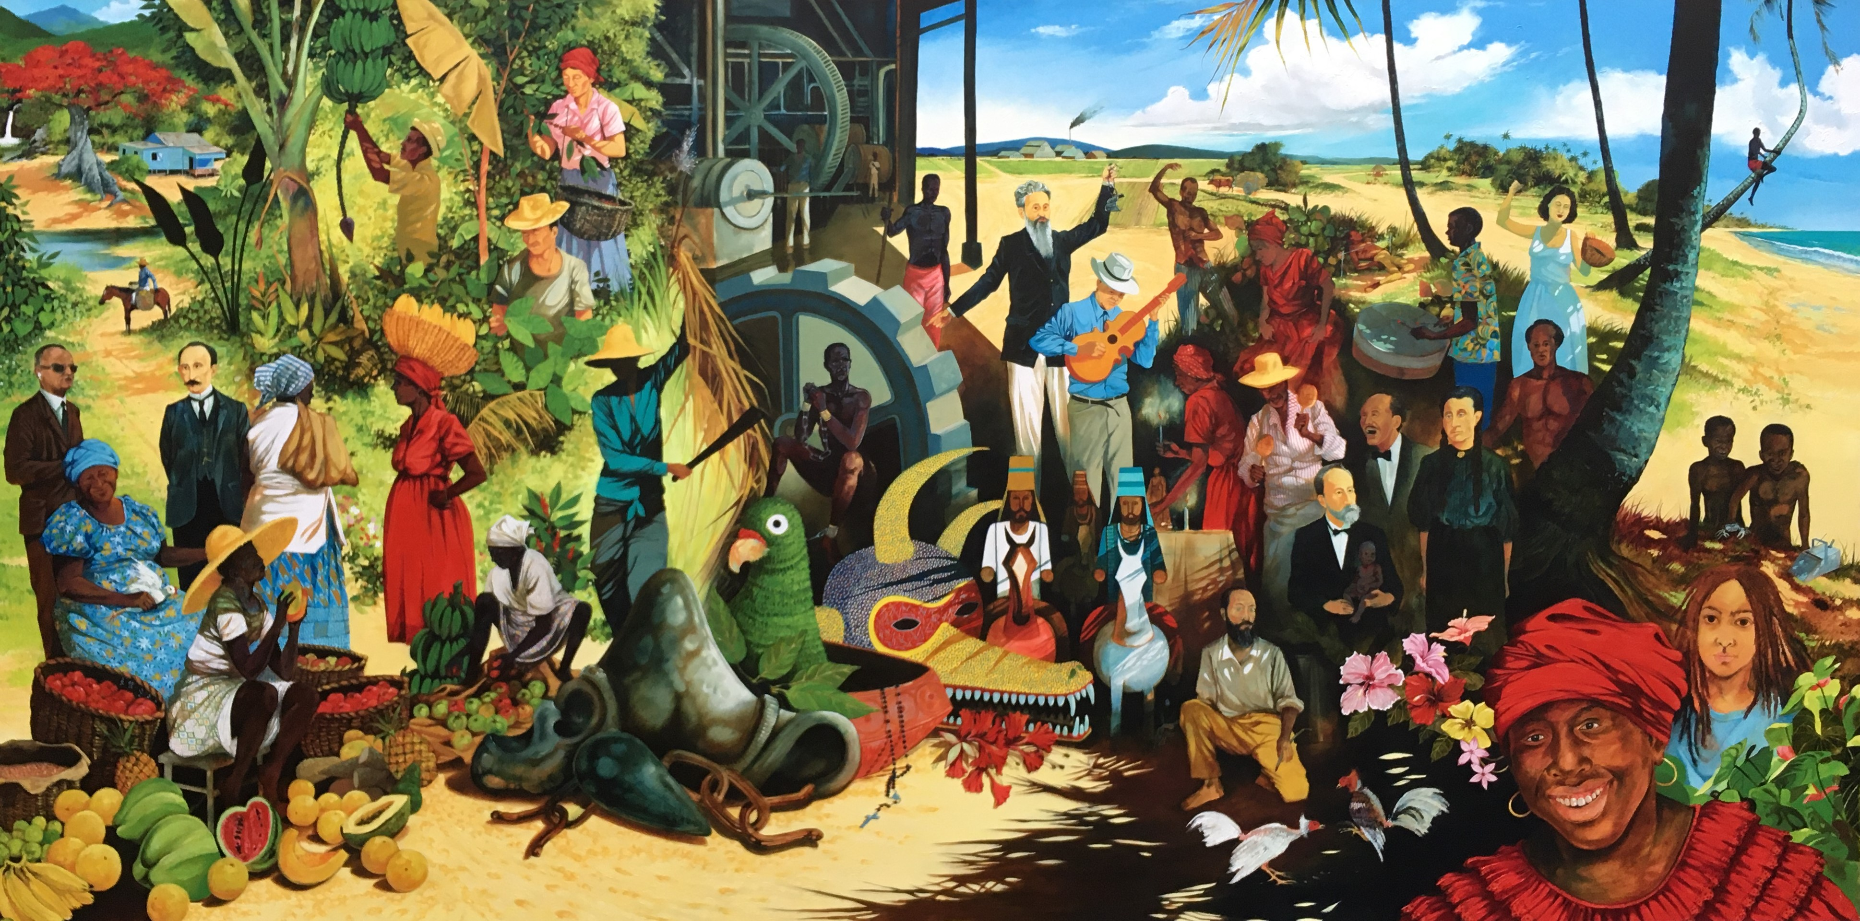
The Latin American, Latino, and Caribbean Center
at CCSU since 1995

Slide 2
Mission Statement
The LALCC promotes the understanding and the appreciation of the historical, social, and cultural life of Latin American and Spanish-Speaking Caribbean societies and of Latinos in the United States through
support for Latino and Latin American Academic programs at CCSU,
LALCC sponsored research projects for faculty and students,
organizing community events,
study abroad,
international exchange,
community outreach and
student engagement and support.
Because of the importance of the Latino community as one of the largest minority groups in the United States, the Center plays an important role in providing educational opportunities to Latino students promoting Latino culture and in maintaining a harmonious relationship with non-Latino cultures.
The Center’s mission is consistent with the University’s mission of fostering diversity and global awareness.

Slide 3
History
Idea developed from student activism in the 1960s and 1970s.
Opened in December 1995 as the Center for Caribbean Studies under the direction of founding director Dr. Ronald Fernandez (1944-2011).
Initial grant from the Connecticut General Assembly
Since 2004 financed by CCSU
Renamed in 2009 to reflect the Center’s current regional and translational focus
Reports to the Provost

Slide 4
Goals Since the Beginning
Encourage learning about Latin America, the Caribbean, and Latino communities in Connecticut and the U.S.
Encourage student study abroad and faculty exchanges.
Reach out to the campus and broader Connecticut community to make clear that Latino/a/x students are welcome here
When founded, CCSU had about 250-300 Latino Students; today we have about 1,700

Slide 5
Location
Initially in the Elihu Burritt Library
Today on the first floor of Willard-Diloreto, D 103
  E-mail: lalcc@ccsu.edu
  Campus phone: 860-832-0056
Currently functioning online due to pandemic
See our website: http://lalcc.comm.ccsu.edu
Find us on Facebook: https://www.facebook.com/lalccatccsu
Find us on YouTube: https://www.youtube.com/channel/UCu3scvHnsOjXT94S2AzMTXQ

Slide 6
Highlight: The “Roots of the Caribbean” Mural

Slide 7
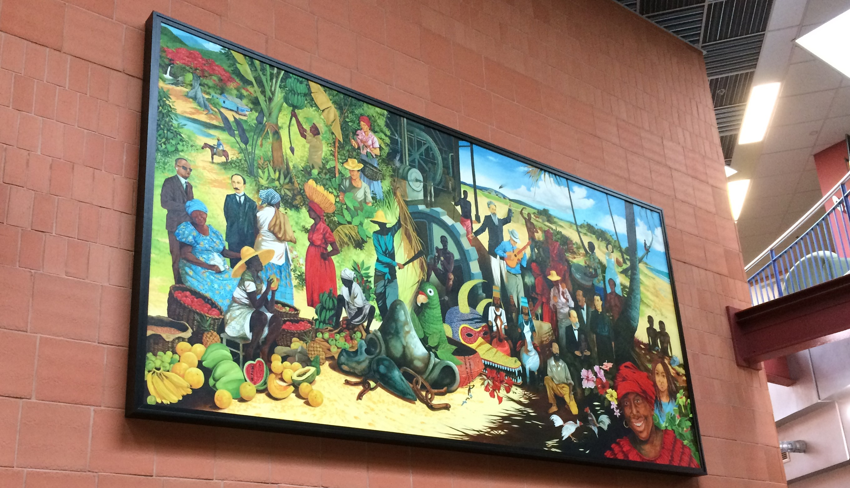
New Location: Student Center Lobby

Slide 8
Events Programming 2020-21:
Hispanic Heritage Month and Beyond
  Panel on Conditions of Latinos in Connecticut and the U.S. with CCSU Latino and Puerto Rican Studies Faculty
  Guest Lecture, Dr. Antonio Curet, National Museum of the American Indian on the archaeology of Puerto Rico
  Panel on Latinos and Politics with Latino members of the Connecticut General Assembly
  Guest lecture in honor of Dr. Dr. Rudolfo Anaya with Dr Juan Armando Rojas and Dr. Rossy Lima de Padilla
  Virtual Day of the Dead on Facebook
  Guest Lecture: Transnational, Transgender, Transformative: The Stories of Adela Vázquez" with Dr. Juana Maria Rodriguez
  Film Showing and Discussion of PBS Series Black in Latin America documentary Haiti and Puerto Rico—co-sponsored with the Africana Center

Slide 9
Ongoing Programming
Mentoring Mondays: 3:00 pm on Teams—Introduce students to key
  programs and processes on campus (so far: Financial Literacy, Scholarships, Advising) Watch for a schedule for spring 2021
Talking Tuesdays: Spanish and/or Portuguese conversation groups
  12:15-1:30 on Teams
Working Groups for Faculty and Students
  Writing Group for Faculty—watch for an e-mail from Dr. Silvia Corbera
  Writing Groups for Grad Students and Undergrads working on M.A./M.S. or Senior theses—coming Spring 2021
Co-sponsored with the Women’s Center—
  Latina Leadership Development Group: Wednesdays at 3:00 pm.

Slide 10
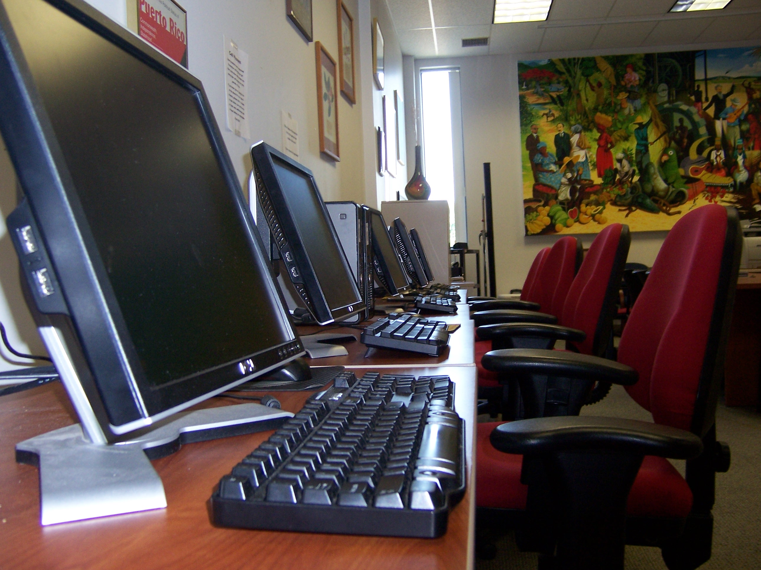
Computer lab
Currently closed due to the pandemic

Slide 11
….Next Semester
Carnival, In collaboration with L.A.S.O. and COLADA
“Families” Conference: Introducing Latino families to the University, in collaboration with Community Engagement and Enrollment Management
Research Conference: “Living in Las Américas: Politics, Health and Society Beyond Borders ”
Brochures and information on the Mural “Roots of the Caribbean” now in the Student Center.

Slide 12
Next Fall
Formal unveiling of “The Roots of the Caribbean” Mural with artist Jorge Luis Morales Torres
Date TBA

Slide 13
Staff
Director, AAUP Faculty, 1 course per semester
University Assistant, 19 hours per semester
Work Study Students

Slide 14
For more information
http://lalcc.comm.ccsu.edu/

