Slide 1
A Report to the UPBC Concerning CCSU’s Athletic Program

Slide 2
Many people will wonder whether or not this proposal will include suggestions to move to another division of the NCAA… it will not.
The reason is simple (and will be presented):
Regardless in what division CCSU participates, there will always be overarching questions about
  revenue enhancement,
  cost savings,
  sustainability,
  transparency,
  balance of spending between athletics and academics, &
  fiscal responsibility.
This report suggests focusing on these topics.

Slide 3
Background

Slide 4
Timeline- 1985 The Move to D1
Resolution of the Board of Trustee (BR#85-79)
“Resolution concerning Intercollegiate Athletics at Central Connecticut State University”
WHEREAS, On May 3, 1985, the Trustees revised their policies for
intercollegiate athletics to require the approval of the Trustees
for a campus to enter Division I as defined by the National
Collegiate Athletic Association and
WHEREAS, Central Connecticut State University has requested approval to enter Division I for all sports except football, therefore be it
RESOLVED, That Central Connecticut State University is authorized to enter Division I as defined by the National Collegiate Athletic
Association for all sports except football.

Slide 5
Timeline- 1985
Expectations From the BoT Regarding Finances
Two other resolutions were passed on that day prior to the previous resolution:
BR#85-77: Trustees policies on Athletics for CSU
The former reflects a BoT policy that stated at the time: “Students participating in intercollegiate athletics shall be eligible for need-based financial aid on the same terms as all other students. However, funds used in support of grants-in-aid to athletes (not based on financial need) shall not be drawn from student fees or monies provided by state and federal agencies.”
BR#85-78: CSU Policy on Intercollegiate Athletics
An acknowledgement by the CSUS that “For some time prior to that revision certain campuses were drawing more money from student fees for the support of intercollegiate athletics than is permitted by the revised policies.” Resolution BR#85-78 addressed a multi-year plan to 1990 to correct the problem.

Slide 6
Timeline- 1990-1991
The Board of Trustees reiterates several points of belief concerning the funding for athletics within the university in BR#91-6 “Policy on Intercollegiate Athletics for Connecticut State University Institutions” as slightly revised policy from 1990 (revising the rescinded BR#90-100).
The policy contained several items of interest:
In the Policy Statement it is stated that the programs should work within the University’s financial resources and be kept in balance with other University programs. However, the guideline specifically state:
6. Annually, each campus President shall submit to the CSU President a full and complete accounting of the intercollegiate athletic program for the prior fiscal year.
7. Annually, each campus president shall submit to the CSU President a budget for the intercollegiate athletic program for the current and subsequent fiscal year.
9. Funds used in support of grants-in-aid to athletes (not based on financial need) shall not be drawn from student tuition, student fees, state appropriations, or federal funds.
10. Annually, each campus president shall submit to the CSU President a list of grants-in-aid awarded to athletes for the prior fiscal year and budgeted for the current and subsequent fiscal year.
21. Prior to December 31st of each year, the CSU President will present an intercollegiate athletic report to the Board of Trustees. This report will present a financial statement for the prior fiscal year and budget for the current and subsequent fiscal years. It will also include an evaluation of the effectiveness of the athletic eligibility of freshman policy.

Slide 7
Sidestep: 1996- BoT Revised 1991 policy
In 1996, the BoT revised the policy on Intercollegiate Athletics to make sure it was in compliance from legislation adopted at the 1996 NCAA convention. The main changes were to implement an initial eligibility index that recentered SAT scores and allowed final admit decisions to be made by each university’s president; however, the overall policy statement and previous items of interest did not change and are (hypothetically) still in effect.

Slide 8
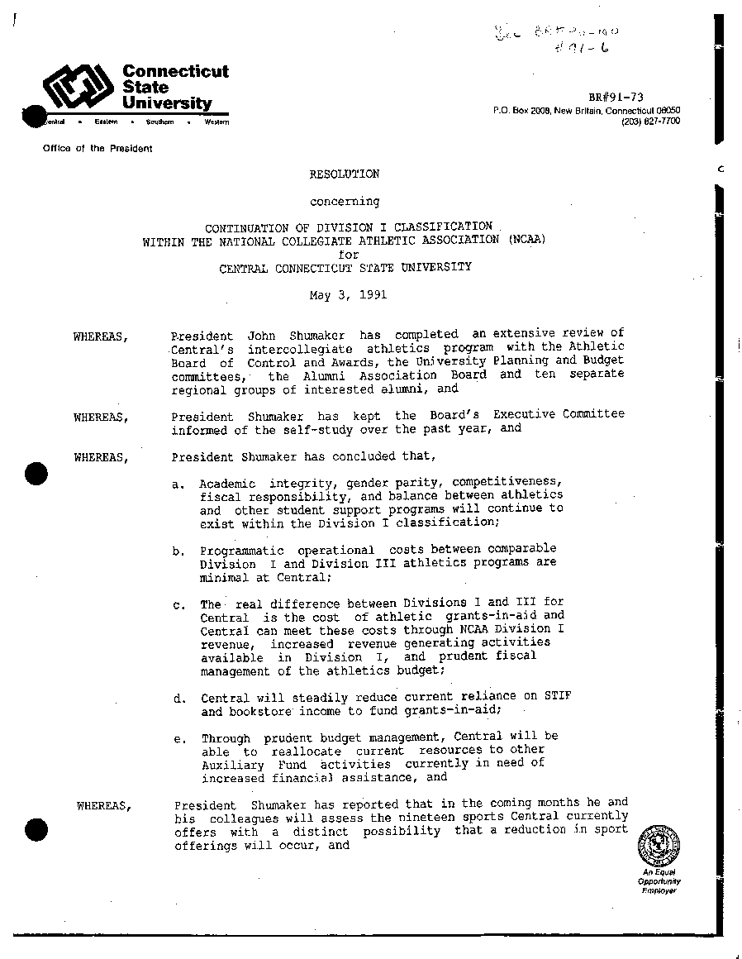
Timeline- 1991
CCSU Reexamines its move
BR#91-73 “Resolution concerning the Continuation of Division I Classification within the NCAA for CCSU”
At the time President Shumaker, the UAB, and UPBC with alumni groups reviewed CCSU program status and concluded:
a. Academic integrity, gender parity, competitiveness,
fiscal responsibility, and balance between athletics
and other student support programs will continue to
exist within the Division I classification;
b. Programmatic operational costs between comparable
Division I and Division III athletics programs are
minimal at Central;
c. The real difference between Divisions I and III for
Central is the cost of athletic grants-in-aid and
Central can meet these costs through NCAA Division I
revenue, increased revenue generating activities
available in Division I, and prudent fiscal
management of the athletics budget;

Slide 9
From Central Courier- May 1991
"One more issue for concern is the budget for athletics. The
state of Connecticut, as everyone knows, faces severe budgetary
difficulties. My decision on whether to remain in Division 1, of
course, must be made, in large part, on whether the intercollegiate athletics program drains University resources and diminishes our ability to provide quality services to our general student body. We must maintain a proper balance between athletics and other student support programs.”
- President Shumaker @ April 11th 1991 Press Conference,

Slide 10
Note: Testing the Claims made in 1991
In order to compare the statements made by President Shumaker in 1991 and the policies of the BoT, I emailed and talked to people at the CSUS in order to get the financial reports for all campuses via guidelines 6 and 7 as well as the financial reports of the Chancellor to the BoT via guideline 21. To date, I have received nothing.
For this presentation, it would have been interesting to chart the year by year expenditures of Eastern and Western (with their Division III programs) against SCSU (Division II) and against CCSU (Division I + FCS) since it would have directly addressed claim (b) made in 1991 by President Shumaker; but it turns out that CCSU has been reporting their revenue/expense data to the NCAA every year. In addition, the NCAA also periodically compiles excellent and available reports concerning average expenditures in all Divisions. Therefore, the majority of the financial data presented is the same financial data given to the NCAA.

Slide 11
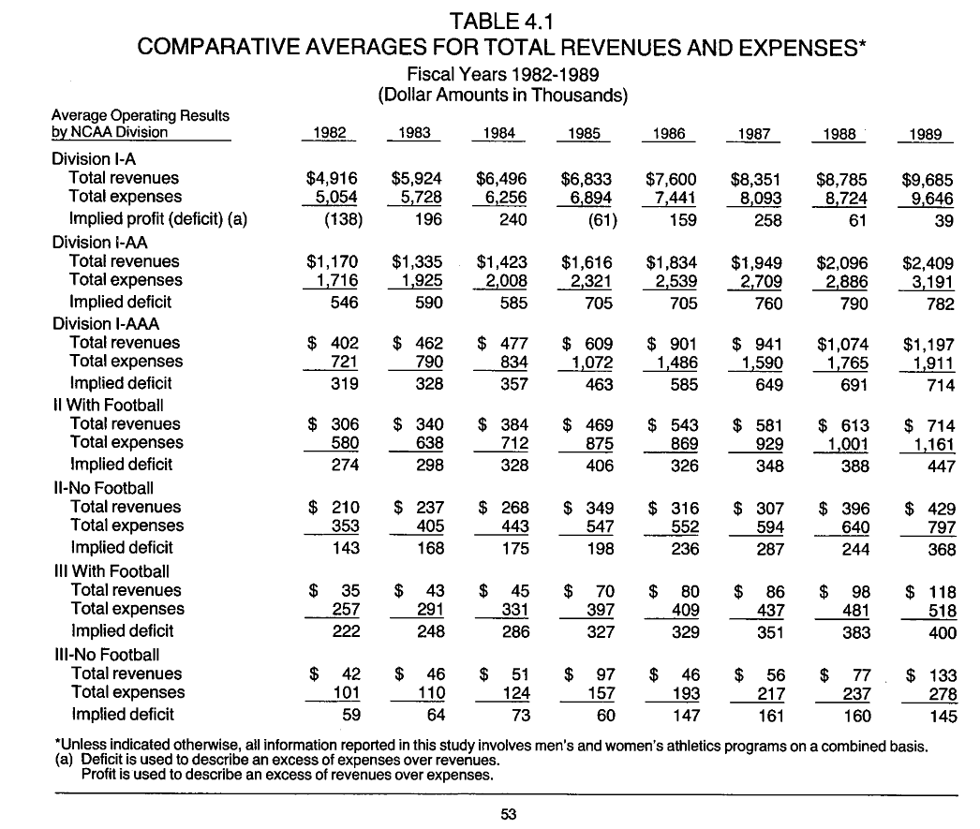
Looking at 1991 Premise (b)
1991 Resolution States:
“b. Programmatic operational costs between comparable
Division I and Division III athletics programs are minimal at Central;”
Even the Earliest of NCAA reports show disparity between operational costs. (Later the report will show that these differences in operational costs have magnified and have become a major concern at all levels of intercollegiate athletics.)
Source: http://fs.ncaa.org/Docs/library/research/i_ii_rev_exp/1990/index.html

Slide 12
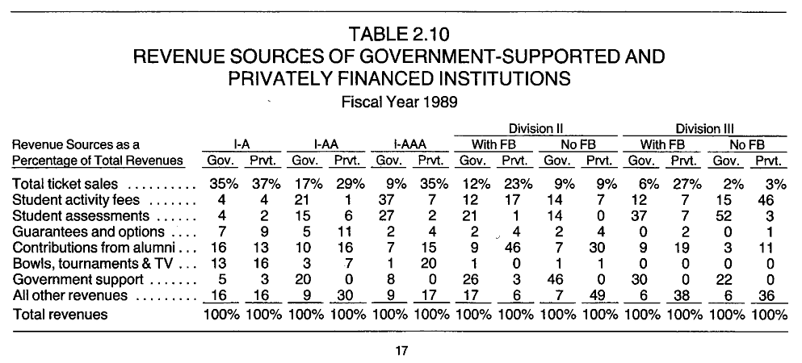
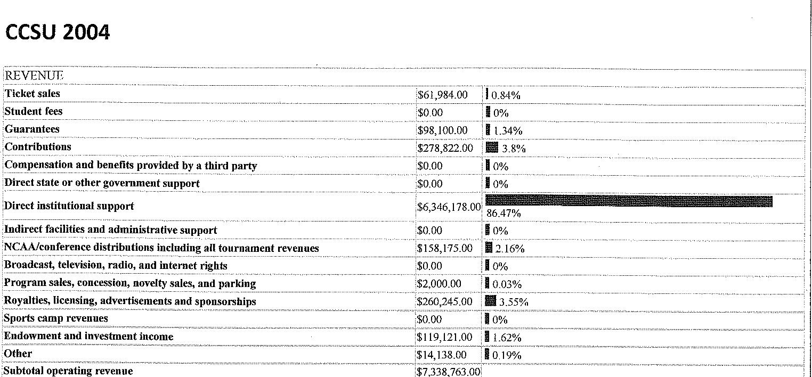
Looking at 1991-- a part of premise (c)
1991 Resolution States:
“c. The real difference between Divisions I and III for Central is the cost of athletic grants-in-aid and Central can meet these costs through NCAA Division I revenue, increased revenue generating activities available in Division I, and prudent fiscal management of the athletics budget;”
Earliest NCAA comparisons of revenue show moderate percentage changes that don’t account for the increase in overall spending; furthermore up until recently the CCSU revenue from ticket sales, options/bowls, endowments, etc. in our program have always been a very small part of our revenue stream.
Source: http://fs.ncaa.org/Docs/library/research/i_ii_rev_exp/1990/index.html

Slide 13
Three questions:
(1) Is There Balance -- Spending on Academics Compared to Spending on Athletics?
(2) Is the Athletic Program Sustainable, and
(3) Where Does the Money to Support Athletics Originate?
“a. Academic integrity, gender parity, competitiveness, fiscal responsibility, and balance between athletics and other student support programs will continue to exist within the Division I classification;” 1991 Resolution
"One more issue for concern is the budget for athletics. The
state of Connecticut, as everyone knows, faces severe budgetary
difficulties. My decision on whether to remain in Division 1, of
course, must be made, in large part, on whether the intercollegiate athletics program drains University resources and diminishes our ability to provide quality services to our general student body. We must maintain a proper balance between athletics and other student support programs.”
- President Shumaker @ April 11th 1991 Press Conference,
“Students participating in intercollegiate athletics shall be eligible for need-based financial aid on the same terms as all other students. However, funds used in support of grants-in-aid to athletes (not based on financial need) shall not be drawn from student fees or monies provided by state and federal agencies.”
-BoT Resolution BR#85-77

Slide 14
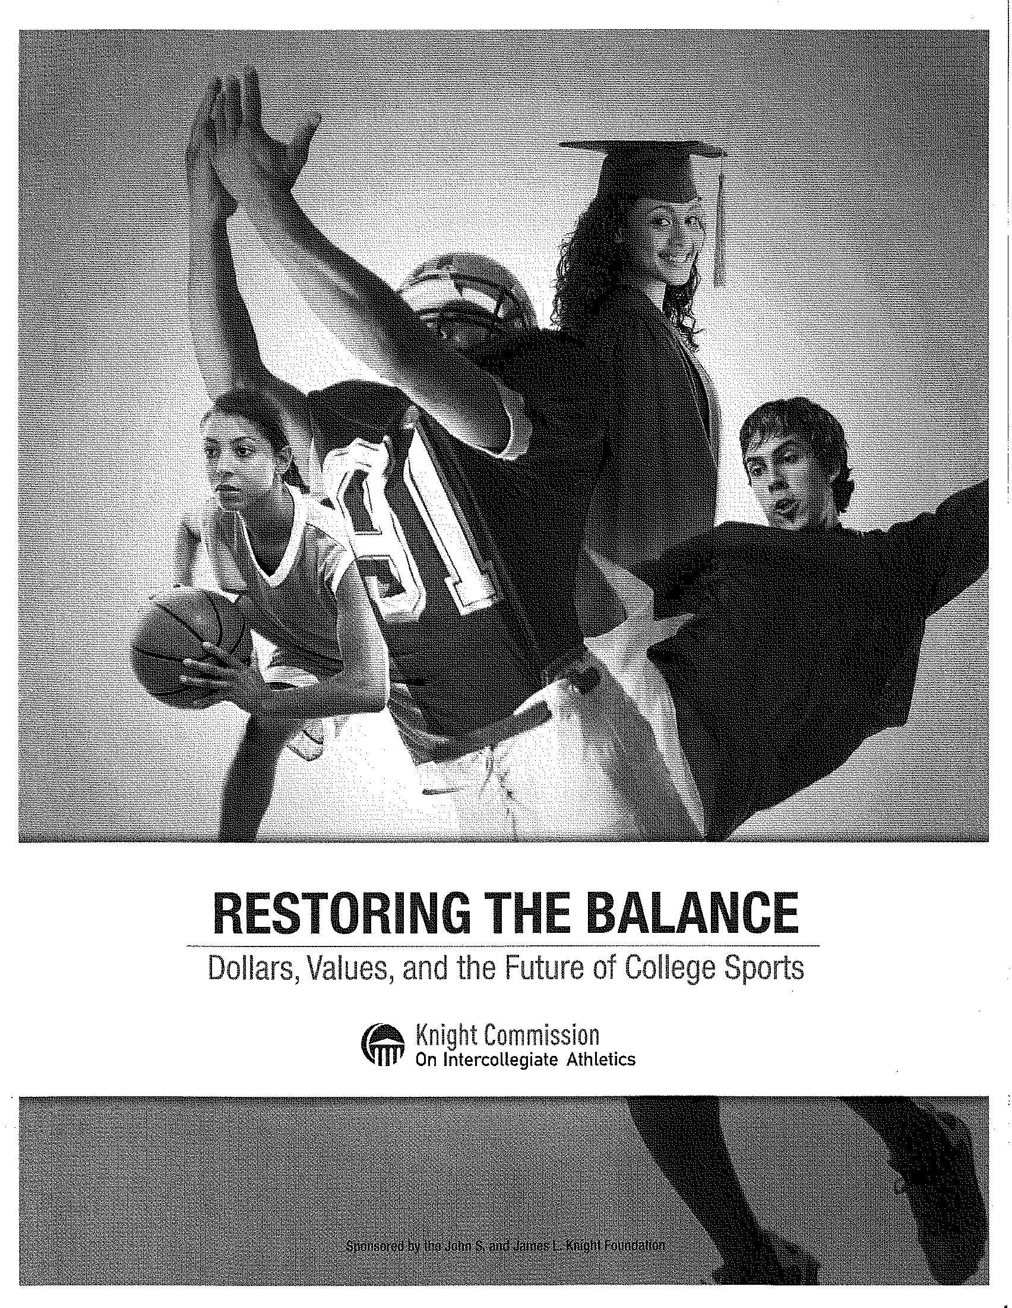
The Wake Up Call:
The 2010 Knight Commission Report
www.knightcommissionmedia.org/.../restoring_the_balance_2010.pdf

Slide 15
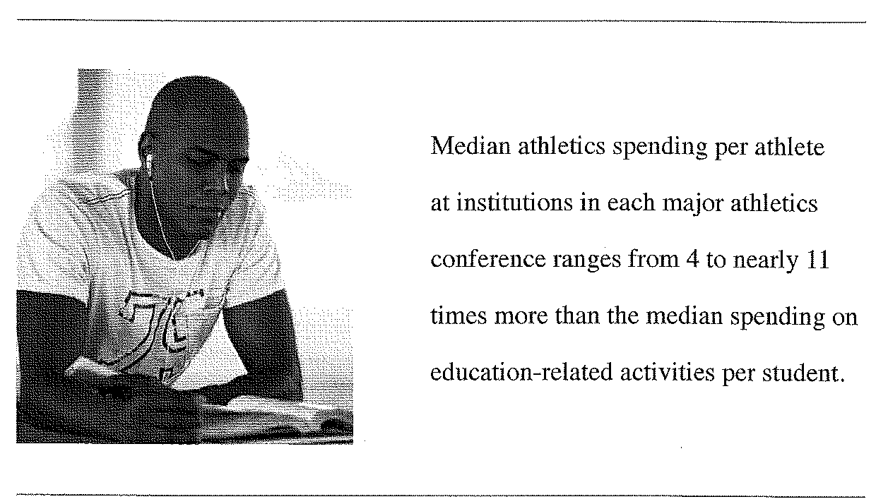
Major Findings
The Knight Commission on Intercollegiate Athletics Releases “Restoring the Balance: Dollars, Values, and the Future of College Sports”
Spending per athlete is rising much faster than spending on education-related activities per student
Athletic programs are competing in a spending race that is not sustainable.

Slide 16
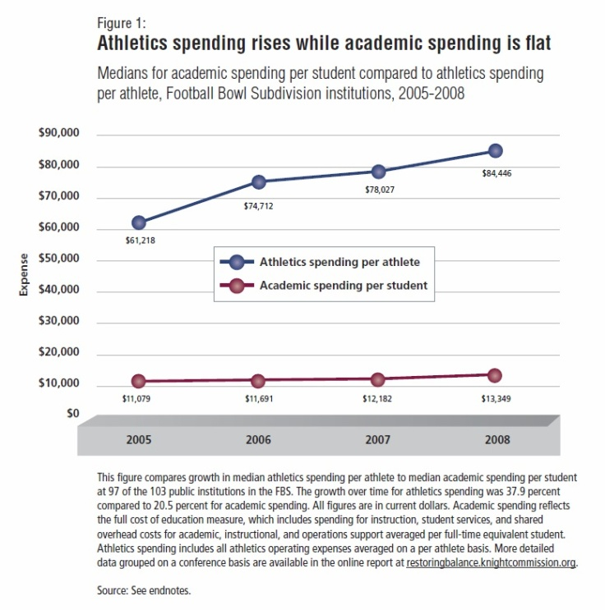
“Spending on Academics” vs. “Spending on Athletics”
The major focus of “Restoring the Balance” was to demonstrate clearly that the race to increase the visibility of a university’s athletic program has lead to unsustainable growth of athletic programs.
The Knight Foundation has proved without a doubt that spending on athletics and the academic success of athletes has far outpaced the academic support of all students.
In general, universities with D1 programs spend more than 5 times as much on a student athlete than it does a normal student. This is reflected as Figure 1 in the Knight Foundation “Restoring the Balance” report [left].

Slide 17
Initial CCSU Data
Recreating this particular graph for CCSU over the years is problematic. Using the USA Today plus numbers obtained from Institutional Planning, we can ballpark the “athletic spending per athlete” even though some of their staff and support functions are not included in the sport budgets. Similarly, the budget obtained for academic side of the picture was obtained from the Provost and may have values included that don’t necessarily reflect the direct expenditures for “academic spending per student”. Despite these glaring problems with number crunching, we can get an overall picture of trends in “academic” versus “athletic” budgets per FTE student and number of student athletes. The general trend for CCSU from 2004-2005 to 2009-2010 is shown below and confirms the general trend that spending on student athletes is growing faster than spending on our students.
 | CCSU Spending on Academics per FTE Student |  |  | CCSU Spending on Athletics per FTE Student
 | Spending¹ | FTE Student² | Spending/FTE | Spending³ | FTE Student² | Spending/FTE
2006-2007 | $63,717,028 | 16,727 | $3,809 | $7,667,580 | 766 | $10,009
2007-2008 | $66,949,952 | 17,118 | $3,911 | $8,172,860 | 768 | $10,641
2008-2009 | $69,489,404 | 17,378 | $3,999 | $8,542,615 | 735 | $11,622
Conservative Ballpark Estimate for CCSU: Spending per Student
¹ Email from CFO Larry Wilder 11/16/2010
² Email from Nancy Hoffman, Institutional Research & Assessment 12/22/2010
³ USA Today NCAA Athletic Finance Database

Slide 18
Is There Balance of Spending on Academics When Compared to Spending on Athletics?
No.

Slide 19
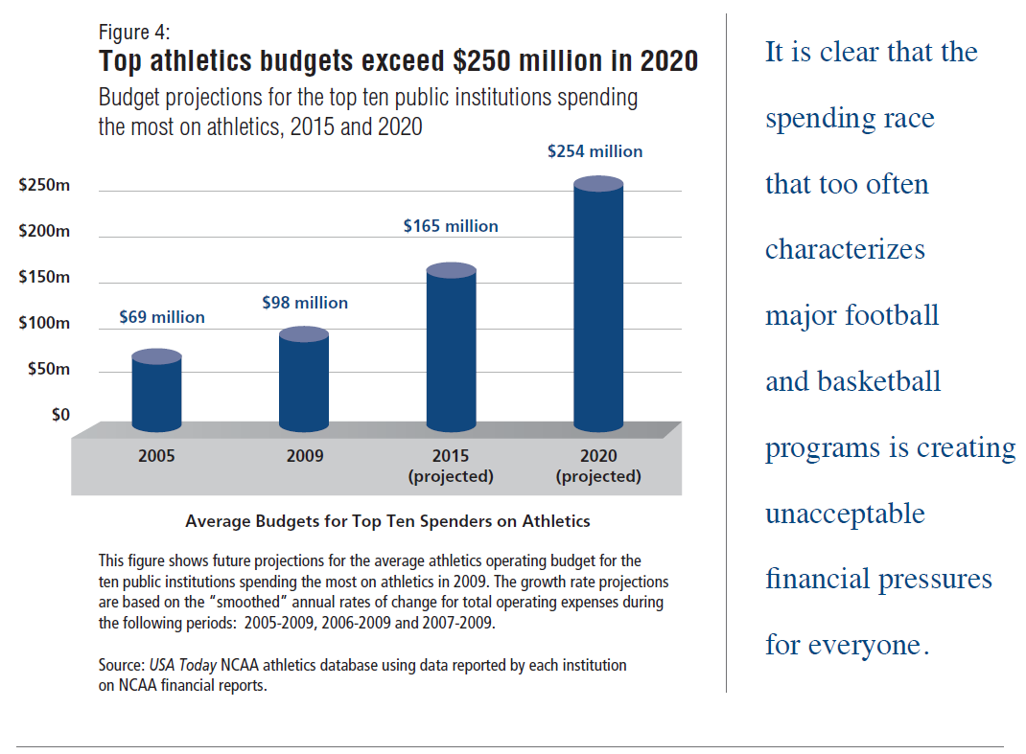
Athletic Arms Race:
Is CCSU’s Growth Model for Athletics Sustainable?
The Knight Foundation also proved that Universities are ramping up athletic spending despite the severe economic restraints placed on public universities.
They tracked the amount a University spends based upon the “size” of the University’s sports program.

Slide 20


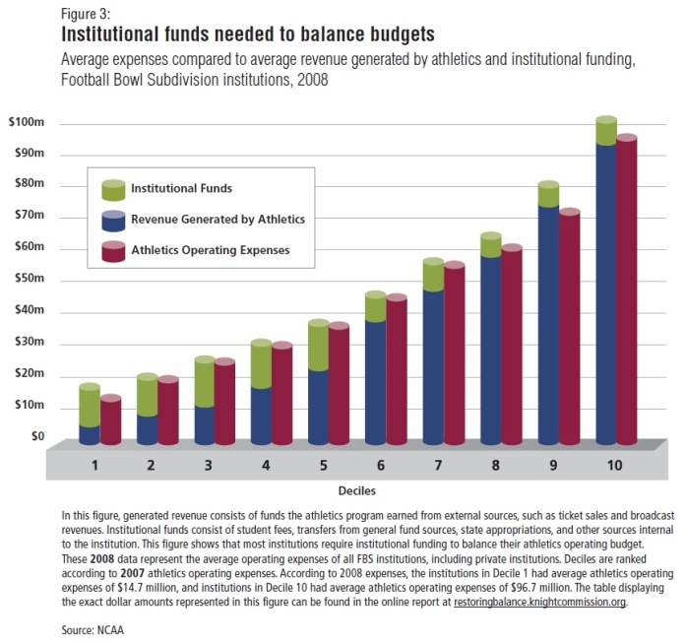
Sustainability of CCSU’s Athletic Program
Figure 3 in “Restoring the Balance” [right] shows the institutional funds needed to balance the budgets of individual sports programs for universities that are involved in the BCS and FCS. The Knight Foundation broke universities into deciles based upon the magnitudes of their annual athletic budget. CCSU has an annual expense of about ~$12 million and falls into the 1st Decile playing in the FCS series. * (UConn has an annual expense of ~$57 million, resides in the 7th Decile and is BCS.)
Notice that Institutional Funds for the 1st Decile >7th Decile
* 2009 CCSU Data (Email: FAR)

Slide 21
Smaller Schools Spend More:
CCSU is No Exception
The 2008 data from the USA Today NCAA Finance Database for both CCSU and UConn mirrors the data presented in Figure 3.
UConn spends only about $5 million in direct administrative support (green) to runs its $57 million dollar program (maroon); whereas CCSU has to rely on $8 million (green) to run its $11 million dollar program (maroon).
In an effort to “keep up with the Joneses”, the schools with the smaller program budgets in the lower deciles, like CCSU, spend a much higher amount via direct administrative support in order to balance the books. In other words, their sports programs reflect a bigger drain on their annual operating budget.
The cause is a revenue shortfall for smaller schools like CCSU.
USA Today NCAA Athletic Finance Database: (web: http://www.usatoday.com/sports/college/ncaa-finances.htm) has CCSU data up to 2008. 2009 data was received from the FAR.

Slide 22
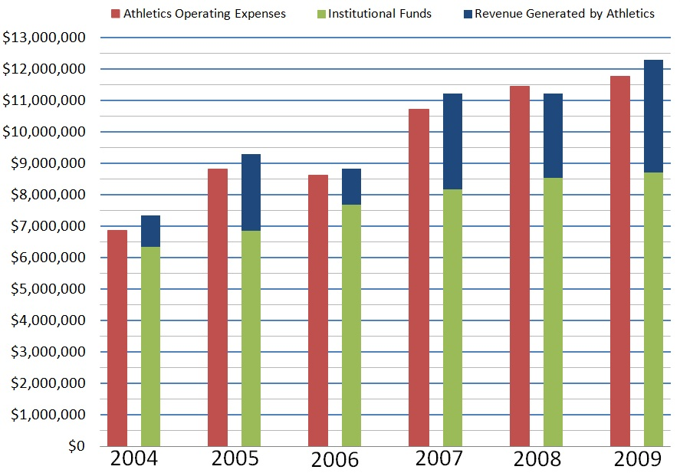
CCSU: From 2004 to 2009
CCSU’s Athletic Program Expenses/Revenue Breakdown

Slide 23
To answer the Question:
Is CCSU’s Athletic Program Sustainable?
Perhaps, but at what cost and who foots the bill?
We have to First Understand and Communicate Where the Money Comes From

Slide 24
For Most Universities, the Money from Direct Administrative Support to Balance the Budget of the Athletic Program Comes From the University’s General Fund.
From Jan-Feb 2011 Change Magazine, A Game Change: Paying for Big-Time College Sports by Karen Weaver:
“Conventional wisdom is that athletics departments function like other auxiliary units on campus: as self-sustaining enterprises. But for many schools, institutional support means the difference between having an athletics program or not. When USA Today examined the 119 Football Bowl Subdivision athletic programs in 2010, the newspaper found that, on average, 60 percent of their income came from the universities' general fund and/or student fees. Subsidies for big-time athletics collectively totaled $800 million in 2009, up 20 percent from four years previously.”
(To put the athletic subsidies in perspective, the CPB received $461 million in federal subsidies in 2009)
http://www.changemag.org/Archives/Back%20Issues/2011/January-February%202011/game-change-full.html
http://www.cpb.org/annualreports/2009/financials.html

Slide 25
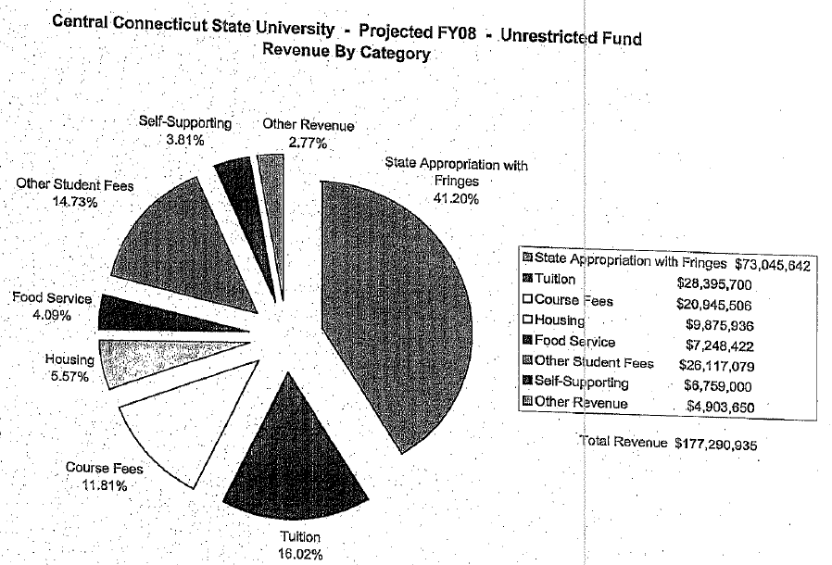
CCSU’s General Fund
This pie graph is a few years old (FY07-08) but it excellently illustrates the different sources of revenue for CCSU including student tuition, student fees, course fees, and state appropriations.
Over the past couple of years, the amount of state appropriations has decreased leading to more reliance on student tuition and fees. This, in turn, means that as spending on athletics is increased then the students and their families bear a greater burden.
http://web.ccsu.edu/upbc/Year07-08/091907_Wilder_FY08%20Spending%20Plan.pdf

Slide 26
CCSU Athletics Rely on the University General Fund
Revenue
Ticket sales | $52,469.00
Student fees | $0.00
Guarantees | $173,785.00
Contributions | $326,357.00
Compensation and benefits provided by a third party | $0.00
Direct state or other government support | $0.00
Direct institutional support | $8,707,849.00
Indirect facilities and administrative support | $2,241,356.00
NCAA/conference distributions including all tournament revenues | $320,006.00
Broadcast, television, radio, and internet rights | $0
Program sales, concession, novelty sales, and parking | $369.00
Royalties, licensing, advertisements and sponsorships | $42,113
Sports camp revenues | $0
Endowment and investment income | $344,990.00
Other | $66,431.00
Subtotal operating revenue | $12,275,725.00
Expenses
Athletic student aid | $3,022,914.00
Guarantees | $0
Coaching salaries, benefits, and bonuses | $2,905,082.00
Coaching other compensation and benefits | $0.00
Support staff/admin salaries, benefits and bonuses | $1,959,079.00
Support staff/admin other compensation and benefits | $0.00
Severance payments | $0.00
Recruiting | $143,258.00
Team travel | $795,653.00
Equipment, uniforms and supplies | $241,646.00
Game expenses | $172,014.00
Fund raising, marketing and promotion | $53,865.00
Sports camps expenses | $0.00
Direct facilities, maintenance, and rental | $61,089.00
Spirit groups | $0
Indirect facilities and administrative support | $2,241,356.00
Medical expenses and medical insurance | $38,568.00
Memberships and dues | $50,110.00
Other operating expenses | $80,185.00
Total operating expenses | $11,764,819.00
2009 Snapshot:
$8.7 million in administrative support
is, by far, biggest source of ‘revenue’
Coaches salaries are
approaching athletic student aid
A growing endowment helps revenue
“Indirect facilities and administrative
support” is both a revenue and an
expense
What does the “Direct institutional support” support?
BoT policy it cannot support athletic student grants-in-aid since it is made up of government funds, student tuition and fees.

Slide 27
Revenue
Ticket sales | $52,469.00
Student fees | $0.00
Guarantees | $173,785.00
Contributions | $326,357.00
Compensation and benefits provided by a third party | $0.00
Direct state or other government support | $0.00
Direct institutional support | $8,707,849.00
Indirect facilities and administrative support | $2,241,356.00
NCAA/conference distributions including all tournament revenues | $320,006.00
Broadcast, television, radio, and internet rights | $0
Program sales, concession, novelty sales, and parking | $369.00
Royalties, licensing, advertisements and sponsorships | $42,113
Sports camp revenues | $0
Endowment and investment income | $344,990.00
Other | $66,431.00
Subtotal operating revenue | $12,275,725.00
Expenses
Athletic student aid | $3,022,914.00
Guarantees | $0
Coaching salaries, benefits, and bonuses | $2,905,082.00
Coaching other compensation and benefits | $0.00
Support staff/admin salaries, benefits and bonuses | $1,959,079.00
Support staff/admin other compensation and benefits | $0.00
Severance payments | $0.00
Recruiting | $143,258.00
Team travel | $795,653.00
Equipment, uniforms and supplies | $241,646.00
Game expenses | $172,014.00
Fund raising, marketing and promotion | $53,865.00
Sports camps expenses | $0.00
Direct facilities, maintenance, and rental | $61,089.00
Spirit groups | $0
Indirect facilities and administrative support | $2,241,356.00
Medical expenses and medical insurance | $38,568.00
Memberships and dues | $50,110.00
Other operating expenses | $80,185.00
Total operating expenses | $11,764,819.00
Taking out “Indirect facilities and administrative support” from both revenue and expense budgets allows one to see what funds the expenses.
Revenues (adjusted):
Direct institutional support: $8,707,849
All other revenue: $1,326,520
There is no obvious way to pay for Athletic Student Aid without dipping into the University’s General Fund. This in turn would be a violation of BoT policy. The BoT has in the past passed resolutions to stop this.

Slide 28
Is the Athletic Program at CCSU Sustainable?
Maybe.
Where Does the Money to Support the Athletic Program Originate?
Right Now? From the Students and State.

Slide 29
The Knight Commission’s Suggestions
The Knight Commission realizes many universities will be looking to solve these problems that are not unique to CCSU. They write:
“This report sets forth reforms that are achievable and that, if implemented, will create a foundation upon which future reforms can build. Our blueprint for restoring educational values and priorities begins with strengthening accountability for intercollegiate athletics in three ways:
1. Requiring greater transparency and the reporting of better measures to compare athletics spending to academic spending
2. Rewarding practices that make academic values a priority
3. Treating college athletes as students first and foremost—not as professionals”

Slide 30
Actions and Possible Solutions

Slide 31
Summary of Problems & Possible Solutions
Problem #1: Spending on athletics should not be rising faster than spending on academics.
Suggested Solution: That the UPBC pass a resolution and send it to the Senate. Perhaps a resolution would require a “spending freeze” on athletics as well as establish a “spending cap” based upon the increase/decrease in base budget of Academic Affairs and Student Affairs.
The general spirit of this proposed change is that the only time the expenses for athletics can rise is when there is a corresponding equal or greater than increase in academics.

Slide 32
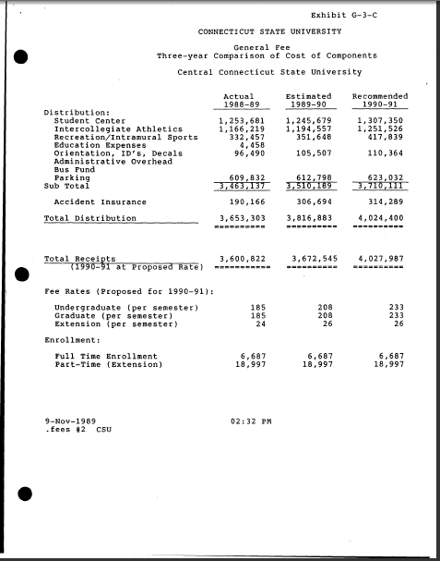
Problem #2: Student fees and student tuition money are used to balance the annual budget of the athletic program and are possibly being used to support athlete grants-in-aid
The First Suggested Solution:
The UPBC move that a separate “CSUS Athletic Fee” be established that clearly shows every student what portion of their fees goes to support the Athletic Program.
(Note: There is a historical precedent here where the old University General Fee had been broken down in such a way as to make this info public knowledge for our students. See BR#89-208 http://www.ct.edu/files/resolutions/89-208.pdf)

Slide 33
Problem #2: (continued) Student fees and student tuition money are used to balance the annual budget of the athletic program and are possibly being used to support athlete grants-in-aid.
Other Suggested Solution(s):
2) The UPBC pass a resolution to the Senate that asks the President to charge an ad hoc long-term planning committee to investigate strategies for revenue generation in athletics as well as possible cost-saving actions. This committee should have adequate representation from the UPBC, UAB, and Faculty Senate.
3) The UPBC can request clarification from the CFO regarding whether or not the BoT policy regarding funds for grants-in-aid for athletes is being violated; specifically if funds from the government or student fees and tuitions are being used. If the policy is being violated, the UPBC should move that the University address the situation such that CCSU is in compliance.

Slide 34
Problem #3: CCSU’s athletic program heavily relies on the University’s General Fund but is not even mentioned in the strategic plan which has budgeting items that are transparent to the University community.
Suggested Solutions:
If the University is to continue spending money on athletics, then it should become a visible part of our mission and strategic plan of CCSU (as should any other ancillary function at the University not directly related to education). The UPBC can suggest it be added.
The UPBC can ask that all financials for our athletic program be circulated annually to the Senate, SGA, and other interested parties.

Slide 35
Why a Suggestion to Move to Another Division Does Not Address the Problem
2009
Data
Division II w/Football (public) | SCSU | Division II w/Football (private) | Division I w/ FCS (public) | CCSU | Division I w/ FCS (private) | Division I BCS (public) | UConn | Division I BCS (private)
$2,241,300 | -note- | $3,912,900 | $4,046,000 | $8,707,849 | $9,803,000 | $2,233,000 | $5,950,265 | $11,075,000
http://www.ncaa.org/wps/wcm/connect/public/NCAA/Resources/Research/Finances+of+Intercollegiate+Athletics

